Slide 1
Functions of Commercial Banks

Slide 2
Introduction
Commercial Bank is the most common type of Bank.
Main aim of this sort of Banks is to maximise the profits.
Main function of the Bank is to accept the Deposit and to give Loan.
Banks accept the Deposits and give interest at lower rates and lend the same Money to others taking higher interest. The difference between them is the Banks Profit.
The Functions of Banks are divided into 2 Parts:-
Primary Functions
Secondary Functions

Slide 3
Primary Functions
Accepting Deposits
Advancing of Loans and Investment

Slide 4
Accepting Deposits
This is most common function of the Bank. Bank receives deposits from common people.
There are 4 Types of Deposits:-
Current Deposit
Saving Deposit
Term/ Time Deposit
Recurring Deposit

Slide 5
Types of Deposits
Current Deposits:- Current Deposits are deposits which can be withdrawn by the Depositer as and when they want. There is no interest on it.
Saving Deposit:- This type of Deposit can be withdrawn but there is a limit i.e. 52 times a year or once a week. The depositer also earns a certain rate of interest on this deposit.
Term/Time Deposit:- This type of Deposit are for a fixed period of time which a depositer selects at the time of making the deposit. The rate of interest is higher on this deposit compared to saving or recurring Deposit.

Slide 6
Types of Deposits
4. Recurring Deposit:- In this, the depositor agrees to pay a specific amount on a specific day or date every month. At the time of Maturity the depositor gets the amount deposited plus interest.

Slide 7
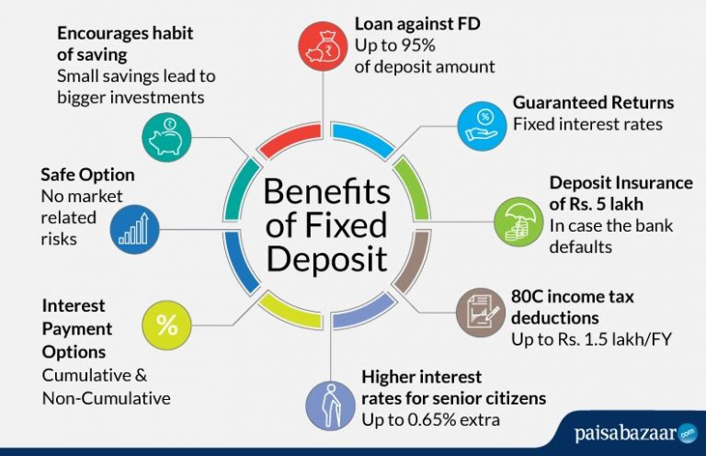
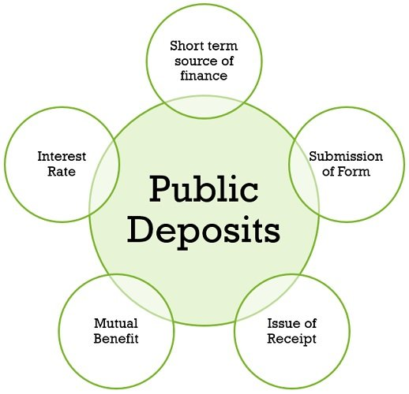

Slide 8
Advancing Loan and Investment
Lending money to the borrowers is a function of bank.
Bank accepts deposits at a lower rate and lends money to borrower at a higher rate.
The difference between the two is income for the Bank. This is a main source of income for the Banks.
Types of Loans:-
Cash Credit
Overdraft Facility
Term Loans
Discounting bills.

Slide 9
Types of Loans
Cash Credit:- A borrower approaches the bank with adequate Security and asks for Money against the security. Bankss after checking the security, gives a sum of money and the borrower is allowed to withdraw from the Bank upto a specific limit.
Overdraft Facility:- Here, a depositor is allowed to withdraw an amount of money over and above his deposit with the Bank. The Bank charges interest on the money which is borrowed.
Term Loans:- The loans which are given for a specific period of time, the amount of the loan is to be repaid after the term is over and in lumpsum.
Discounting bills:- Bill Discounting is a trade-related activity in which a company's unpaid invoices which are due to be paid at a future date are sold to a financer

Slide 10
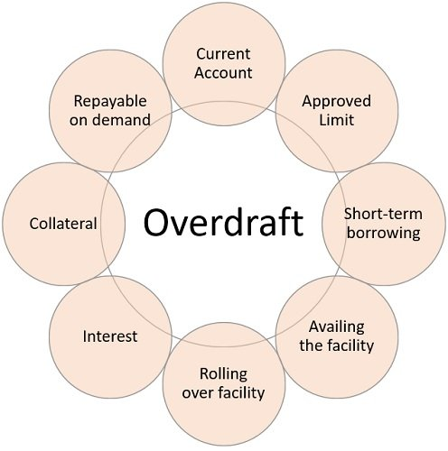
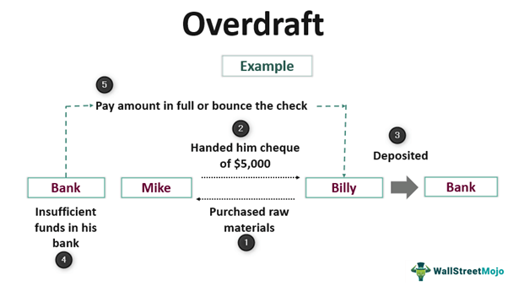

Slide 11
Secondary Functions
Secondary Functions are divided into 2 parts:-
Agency Functions
General Utility services

Slide 12
Agency Functions
In order to facilitate customers, the Banks accept standing instructions from their customers either to make payments on their behalf or to collect or transfer money. The relationship between the Banker and Customer here is similar to a Principal and Agent.
The Banks charge money for providing such services.

Slide 13
General Utility Services
General Utility services are:-
Safe Custody Deposits
Safe Deposit Locker
Transfer of Money
Travellers cheque
Automatic Teller Machine(ATM)
Credit Cards

Slide 14
Thank You!

